Slide 1
Unit -II

Slide 2
Divide and Conquer Technique
General Method:
The Divide and Conquer Technique splits n inputs into k subsets , 1< k ≤ n, resulting k subproblems.
These subproblems will be solved and then combined by using a separate method to get a solution to the whole problem.
If the subproblems are large, then the Divide and Conquer Technique will be reapplied.
Generally, subproblems coming from a Divide and Conquer Technique are of the same type as the original problem.

Slide 3
The reapplication of the Divide and Conquer Technique is naturally expressed by a recursive algorithm.
Now smaller and smaller problems of the same kind are generated until subproblems that are small enough to solve without splitting further.

Slide 4
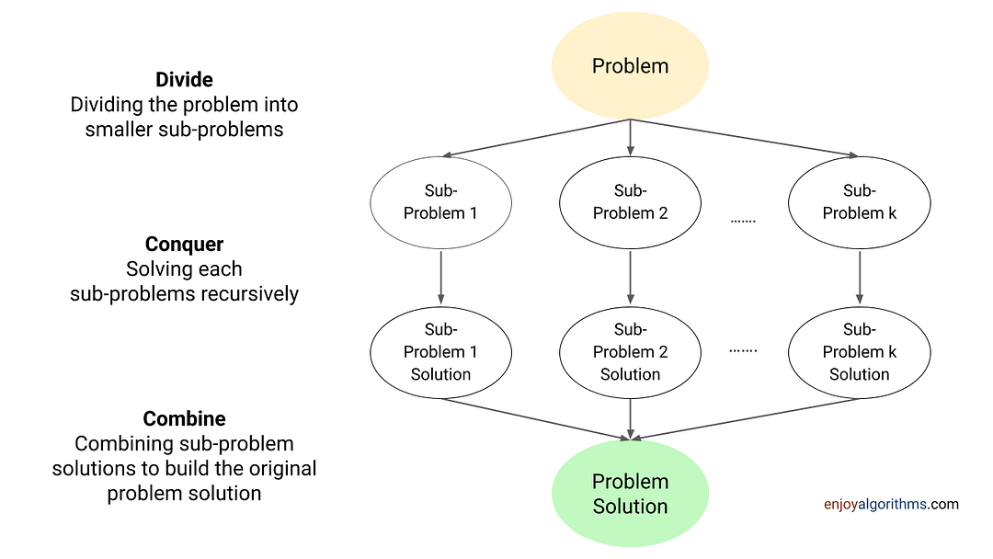

Slide 5
Control Abstraction / General Method for Divide and Conquer Technique
Algorithm DAndC(p)
{
if Small(p) then return s(p);
else
{
divide p into smaller problems p1,p2,…….,pk, k≥1;
Apply DAndC to each of these subproblems;
return Combine(DAndC(p1), DAndC(p2),……,DAndC(pk));
}
}

Slide 6
The Time Complexity of many divide-and-conquer algorithms is given by recurrences of the form
T(1) when n=1
aT(n/b)+f(n) when n>1
Where T(n) is the time for DAndC on any input of size n
The function f(n) is the time for dividing the problem and combining the solutions of subproblems.
Where a, b are known constants, we assume that T(1) is known and n is a power of b (i.e., n = b^{k} )
T(n)=

Slide 7
Applications
1.Binary search Algorithm
Iterative Method
Algorithm BinSearch(a, n, x)
// a is an array of size n, x is the key element to be searched.
{ low:=1; high:=n;
while( low ≤ high)
{
mid:=(low+high)/2;
if( x < a[mid] ) then high := mid-1;
else if( x > a[mid] ) then low := mid+1;
else return mid;
}
return 0;
}

Slide 8
Recursive Algorithm ( Divide and Conquer Technique)
Algorithm BinSrch (a, low, high, x)
//Given an array a [ low : high ]of elements in increasing
//order,1≤low≤high,determine whether x is present, and
//if so, return j such that x=a[j]; else return 0.
{
if( low = high ) then // If small(P)
{
if( x=a[low] ) then return low;
else return 0;
}
else

Slide 9
{
//Reduce p into a smaller subproblem.
mid:= (low+high)/2
  if( x = a[mid] ) then return mid;
  else if ( x<a[mid] ) then
  return BinSrch(a, low, mid-1, x);
  else
  return BinSrch(a, mid+1, high, x);
  }
  }

Slide 10
Time complexity of Binary Seaych
If the time for diving the list is a constant, then the computing time for binary search is described by the recurrence relation
T(n) = c₁ n=1, c1 is a constant
T(n/2) + c₂ n>1, c2 is a constant
Assume n = 2^{k}, then
    T(n) = T(n/2) + c2
    =T(n/4)+c2+c2
    =T(n/8) +c2+c2+c2
    …..
    …..
    = T( n / 2^{k}) + c2+c2+c2+ ………..k times
    = T(1)+ kc2
    = c1+kc2 =c1+ logn*c2 = O(logn)

Slide 11
Time Complexity of Binary Search
Successful searches:
best average worst
O(1) O(log n) O( log n)
Unsuccessful search:
O(log n)

Slide 12
2. Merge Sort
Base Case, solve the problem directly if it is small enough(only one element).
Divide the problem into two or more similar and smaller subproblems.
Recursively solve the subproblems.
Combine solutions to the subproblems.

Slide 13
Merge Sort: Idea
Divide into
two halves
A
FirstPart
SecondPart
Recursively sort
Recursively sort
FirstPart
SecondPart
Merge
A is sorted!
Notes:
Divide: if the initial array A has at least two elements (nothing needs to be done if A has zero or one elements), divide A into two subarrays each containing about half of the elements of A.
Conquer: sort the two subarrays using Merge Sort.
Combine: merging the two sorted subarray into one sorted array

Slide 14
Merge-Sort(A, 0, 7)
Divide
A:
6 2 8 4
3 7 5 1
6 2 8 4 3 7 5 1

Slide 15
Merge-Sort(A, 0, 7)
Merge-Sort(A, 0, 3)
, divide
A:
3 7 5 1
6 2
8 4
6 2 8 4

Slide 16
Merge-Sort(A, 0, 7)
Merge-Sort(A, 0, 1)
, divide
A:
3 7 5 1
8 4
6
2
6 2

Slide 17
Merge-Sort(A, 0, 7)
Merge-Sort(A, 0, 0)
, base case
A:
3 7 5 1
8 4
2
6

Slide 18
Merge-Sort(A, 0, 7)
Merge-Sort(A, 0, 0), return
A:
3 7 5 1
8 4
6
2

Slide 19
Merge-Sort(A, 0, 7)
Merge-Sort(A, 1, 1)
, base case
A:
3 7 5 1
8 4
6
2

Slide 20
Merge-Sort(A, 0, 7)
Merge-Sort(A, 1, 1), return
A:
3 7 5 1
8 4
6
2

Slide 21
Merge-Sort(A, 0, 7)
Merge(A, 0, 0, 1)
A:
3 7 5 1
8 4
2 6

Slide 22
Merge-Sort(A, 0, 7)
Merge-Sort(A, 0, 1), return
A:
3 7 5 1
2 6
8 4

Slide 23
Merge-Sort(A, 0, 7)
Merge-Sort(A, 2, 3)
, divide
A:
3 7 5 1
2 6
8
4
8 4

Slide 24
Merge-Sort(A, 0, 7)
Merge-Sort(A, 2, 2), base case
A:
3 7 5 1
2 6
4
8

Slide 25
Merge-Sort(A, 0, 7)
Merge-Sort(A, 2, 2), return
A:
3 7 5 1
2 6
8
4

Slide 26
Merge-Sort(A, 0, 7)
Merge-Sort(A, 3, 3), base case
A:
2 6
8
4

Slide 27
Merge-Sort(A, 0, 7)
Merge-Sort(A, 3, 3), return
A:
3 7 5 1
2 6
8
4

Slide 28
Merge-Sort(A, 0, 7)
Merge(A, 2, 2, 3)
A:
3 7 5 1
2 6
4 8

Slide 29
Merge-Sort(A, 0, 7)
Merge-Sort(A, 2, 3), return
A:
3 7 5 1
2 6
4 8

Slide 30
Merge-Sort(A, 0, 7)
Merge(A, 0, 1, 3)
A:
3 7 5 1
2 4 6 8

Slide 31
Merge-Sort(A, 0, 7)
Merge-Sort(A, 0, 3), return
A:
2 4 6 8
3 7 5 1

Slide 32
Merge-Sort(A, 0, 7)
Merge-Sort(A, 4, 7)
A:
2 4 6 8
3 7 5 1

Slide 33
Merge-Sort(A, 0, 7)
Merge (A, 4, 5, 7)
A:
2 4 6 8
1 3 5 7

Slide 34
Merge-Sort(A, 0, 7)
Merge-Sort(A, 4, 7), return
A:
2 4 6 8
1 3 5 7

Slide 35
Merge-Sort(A, 0, 7)
Merge-Sort(A, 0, 7), done!
Merge(A, 0, 3, 7)
A:
1 2 3 4 5 6 7 8

Slide 36
Ex:- [ 179, 254, 285, 310, 351, 423, 450, 520, 652,861 ]
Tree of calls of merge sort
1,10
1,5
6,10
1,3
4,5
6,8
9,10
1,2
3,3
4,4
5,5
6,7
8,8
9,9
10,10
1,1
2,2
6,6
7,7

Slide 37
Merge Sort: Algorithm
MergeSort ( low,high)
// sorts the elements a[low],…,a[high] which are in the global array
//a[1:n] into ascending order ( increasing order ).
// Small(p) is true if there is only one element to sort. In this case the list is
// already sorted.
{ if ( low<high ) then // if there are more than one element
{
mid ← (low+high)/2;
    MergeSort(low,mid);
    MergeSort(mid+1, high);
    Merge(low, mid, high);
}
}
Recursive Calls

Slide 38
Merge-Sort: Merge Example
low
mid
high
A:
2
3
7
8
1
4
5
6
5
5
15
28
30
6
10
14
B:
5
5
15
28
30
6
10
14
L:
R:
3
5
15
28
6
10
14
22

Slide 39
Merge-Sort: Merge Example
A:
5
5
15
28
30
6
10
14
B:
3
1
5
15
28
30
6
10
14
i=low
L:
mid
R:
low
high
3
2
15
3
28
7
30
8
6
1
10
4
14
5
22
6
h=low
j=mid+1

Slide 40
Merge-Sort: Merge Example
A:
5
5
15
28
30
6
10
14
B:
1
2
5
15
28
30
6
10
14
i
L:
mid
R:
low
high
3
2
5
3
15
7
28
8
6
1
10
4
14
5
22
6
h
j

Slide 41
Merge-Sort: Merge Example
A:
5
5
15
28
30
6
10
14
B:
1
2
3
15
28
30
6
10
14
i
L:
mid
R:
low
high
2
3
7
8
6
1
10
4
14
5
22
6
h
j

Slide 42
Merge-Sort: Merge Example
A:
5
5
15
28
30
6
10
14
B:
1
2
3
4
6
10
14
i
L:
mid
R:
low
high
2
3
7
8
6
1
10
4
14
5
22
6
h
j

Slide 43
Merge-Sort: Merge Example
A:
5
5
15
28
30
6
10
14
B:
1
2
3
4
5
6
10
14
i
L:
mid
R:
low
high
2
3
7
8
6
1
10
4
14
5
22
6
h
j

Slide 44
Merge-Sort: Merge Example
A:
5
5
15
28
30
6
10
14
B:
1
2
3
4
5
6
6
10
14
i
L:
mid
R:
low
high
2
3
7
8
6
1
10
4
14
5
22
6
h
j

Slide 45
Merge-Sort: Merge Example
A:
5
5
15
28
30
6
10
14
B:
1
2
3
4
5
6
7
14
i
L:
mid
R:
low
high
2
3
7
8
6
1
10
4
14
5
22
6
h
j

Slide 46
Merge-Sort: Merge Example
A:
5
5
15
28
30
6
10
14
B:
1
2
3
4
5
6
7
8
14
i
L:
mid
R:
low
high
3
2
5
3
15
7
28
8
6
1
10
4
14
5
22
6
h
j

Slide 47
Merge-Sort: Merge Example
A:
5
5
15
28
30
6
10
14
B:
1
2
3
4
5
6
7
8
i
L:
mid
R:
low
high
3
2
5
3
15
7
28
8
6
1
10
4
14
5
22
6
h
j

Slide 48
A:
5
5
15
28
30
6
10
14
B:
1
2
3
4
5
6
7
8

Slide 49
Algorithm Merge(low,mid,high)
// a[low:high] is a global array containing two sorted subsets in a[low:mid]
// and in a[mid+1:high]. The goal is to merge these two sets into a single
// set residing in a [low:high]. b[ ] is a temporary global array.
{
h:=low; j:=mid+1; i:=low;
while( h ≤ mid ) and ( j ≤ high ) do
{
if( a[h] ≤ a[j] ) then
{
b[i]:=a[h]; h:=h+1;
}
else
{
b[i]:=a[j]; j:=j+1;
}
i:=i+1;
}

Slide 50
if( h > mid ) then
for k:=j to high do
{
b[i] := a[k]; i:= i+1;
}
else
for k:=h to mid do
{
b[i] := a[k]; i:= i+1;
}
for k:= low to high do a[k]:=b[k];
}

Slide 51
Merge-Sort Analysis
n
n/2
n/2
n/4
n/4
n/4
n/4
2
2
2

Slide 52
Merge-Sort Time Complexity
If the time for the merging operation is proportional to n, then the computing time for merge sort is described by the recurrence relation
c₁
n=1, c₁ is a constant
T(n) =
2T(n/2) + c₂n
n>1, c₂ is a constant
Assume n=2^{k}, then
    T(n) =2T(n/2) + c₂n
    =2(2T(n/4)+c2n/2)+c₂n
    =4T(n/4)+2c₂n
    …..
    …..
    =2^{k} T(1)+ kc₂n
    = c₁n+c₂nlogn = = O(nlogn)

Slide 53
Summary
Merge-Sort
  Most of the work done in combining the solutions.
  Best case takes o(n log(n)) time
  Average case takes o(n log(n)) time
  Worst case takes o(n log(n)) time
Notes:
no specific input triggers worst-case behavior
the worst-case is only determined by the output of the random-number generator
Disadvantage:
Unstable in running time
Finding “pivot” element is a big issue!

Slide 54
3. Quick Sort
Divide:
    Pick any element as the pivot, e.g, the first element
    Partition the remaining elements into
        FirstPart, which contains all elements < pivot
        SecondPart, which contains all elements > pivot
Recursively sort FirstPart and SecondPart.
Combine: no work is necessary since sorting is done in place.
Notes:
since sorting is done in place

Slide 55
pivot divides a into two sublists x and y.
4
4
2
2
7
7
8
8
1
1
9
9
3
3
6
6
5
5
pivot
4
x
y

Slide 56
The whole process
4
2
7
8
1
9
3
6
5
2
1
3
4
7
8
9
6
5
1
2
3
6
5
7
8
9
1
3
5
6
8
9
5
9

Slide 57
Process:
Keep going from left side as long as a[ i ]<pivot and from the right side as long as a[ j ]>pivot
pivot
85 24 63 95 17 31 45 98
i
j
85 24 63 95 17 31 45 98
i
j
85 24 63 95 17 31 45 98
i
j
85 24 63 95 17 31 45 98
i
j

Slide 58
If i<j interchange i^{th} and j ^{th} elements and then Continue the process.
85 24 63 45 17 31 95 98
i
j
85 24 63 45 17 31 95 98
i
j
85 24 63 45 17 31 95 98
i

Slide 59
85 24 63 45 17 31 95 98
j
i
85 24 63 45 17 31 95 98
j
i
If i ≥j interchange j^{th} and pivot elements and then divide the list into two sublists.

Slide 60
35 24 63 45 17 85 95 98
j
Two sublists:
35 24 63 45 17
95 98
85
Recursively sort
      FirstPart and SecondPart
      QickSort( low, j-1 ) QickSort( j+1,high )

Slide 61
Quick Sort Algorithm :
Algorithm QuickSort(low,high)
//Sorts the elements a[low],…..,a[high] which resides
//in the global array a[1:n] into ascending order;
// a[n+1] is considered to be defined and must ≥ all the
// elements in a[1:n].
{
if( low< high ) // if there are more than one element
{ // divide p into two subproblems.
j :=Partition(low,high);
// j is the position of the partitioning element.
QuickSort(low,j-1);
QuickSort(j+1,high);
// There is no need for combining solutions.
}
}

Slide 62
Algorithm Partition(low, high)
{
pivot:= a[ low ]; i:=low; j:= high+1;
while( i < j ) do
{
i++;
while( a[ i ] < pivot ) do
i++;
j--;
while( a[ j ] > pivot ) do
j--;
if ( i < j ) then Interchange(i, j ); // interchange i^{th} and
} // j^{th} elements.
Interchange(low, j ); return j; // interchange pivot and j^{th} element.
}

Slide 63
Algorithm interchange (x,y )
{
temp=a[x];
a[x]=a[y];
a[y]=temp;
}

Slide 64
Time complexity analysis
The time required to sort n elements using quicksort involves 3 components.
  Time required for partitioning the array, which is roughly proportional to n.
  Time required for sorting lower subarray.
  Time required for sorting upper subarray.
Assume that there are k elements in the lower subarray.
Therefore,
c₁
n=1, c₁ is a constant
T(n) =
T(k) + T(n-k-1) +c₂n
n>1, c₂ is a constant

Slide 65
A worst/bad case
It occurs if the list is already in sorted order
1
2
3
4
5
6
7
8
9
1
2
3
4
5
6
7
8
9
2
3
4
5
6
7
8
9
3
4
5
6
7
8
9
4
5
6
7
8
9
O(n²)
5
6
7
8
9
6
7
8
9
7
8
9
8
9
9

Slide 66
Worst/bad Case
n
cn
n-1
c(n-1)
n-2
c(n-2)
3c
3
2
2c
1c
1

Slide 67
contd...
In the worst case, the list is always partitioned into two sublists in which one of them is always empty. Thus , for the worst case analysis,
T(n) =
T(n-1) +c₂n
n > 1, c₂ is a constant
=
T(n-1) +c₂n
=
T(n-2) + c₂ ( n -1)+ c₂n
=
T(n-3) + c₂ ( n -2) + c₂( n -1)+c₂n
    …..
    …..
= n(n+1)/2 = ( n²+n)/2= O(n²)

Slide 68
A Best/Good case
It occurs only if each partition divides the list into two equal size sublists.
O(n logn)

Slide 69
Best/Good Case
n
n/2
n/2
n/4
n/4
n/4
n/4
2
2
2

Slide 70
c₁
n=1, c₁ is a constant
T(n) =
2T(n/2) + c₂n
n>1, c₂ is a constant
Assume n=2^{k}, then
    T(n) =2T(n/2) + c₂n
    =2(2T(n/4)+c₂n/2)+c₂n
    =4T(n/4)+2c₂n
    …..
    …..
    =2^{k} T(1)+ kc₂n
    = c₁n+c₂nlogn = = O(nlogn)

Slide 71
Summary
Quick-Sort
  Most of the work done in partitioning
  Best case takes O(n log(n)) time
  Average case takes O(n log(n)) time
  Worst case takes O(n²) time
Notes:
no specific input triggers worst-case behavior
the worst-case is only determined by the output of the random-number generator
Disadvantage:
Unstable in running time
Finding “pivot” element is a big issue!

Slide 72
4.Strassen’s Matrix Multiplication

Slide 73
Basic Matrix Multiplication
Let A an B two n×n matrices. The product C=AB is also an n×n matrix.
void matrix_mult (){
for (i = 1; i <= n; i++) {
for (j = 1; j <= n; j++) {
for(k=1; k<=n; k++){
C[i,j]=C[i,j]+A[i,k]+B[k,j]; }
}}
Time complexity of above algorithm is
T(n)=O(n³)

Slide 74

Divide and Conquer Technique
We want to compute the product C=AB, where each of A,B, and C are n×n matrices.
Assume n is a power of 2.
If n is not a power of 2, add enough rows and columns of zeros.
We divide each of A,B, and C into four n/2×n/2 matrices, rewriting the equation C=AB as follows:

Slide 75
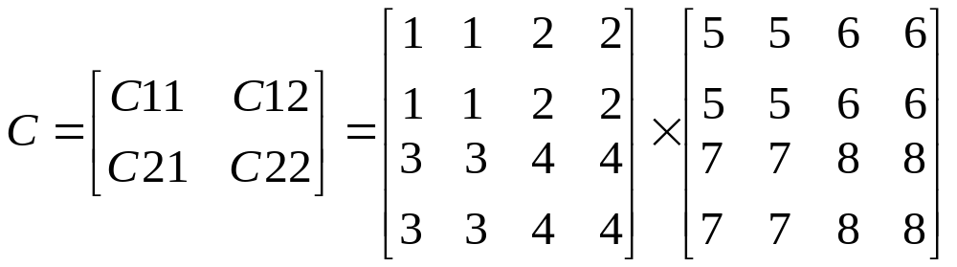
Then,
C₁₁=A₁₁B₁₁+A₁₂B₂₁
C₁₂=A₁₁B₁₂+A₁₂B₂₂
C₂₁=A₂₁B₁₁+A₂₂B₂₁
C₂₂=A₂₁B₁₂+A₂₂B₂₂
Each of these equations specifies two multiplications of size n/2×n/2 and the addition of their n/2×n/2 products.
We can derive the following recurrence relation for the time T(n) to multiply two n×n matrices:
T(n)= c₁ if n<=2
8T(n/2)+ c₂n² if n>2
A₁₁
A₁₂
B₁₁
B₁₂
c₁₁
c₁₂
c₂₁
c₂₂
A₂₁
A₂₂
B₂₁
B₂₂
T(n) = O(n³)
This method is no faster than the ordinary method.

Slide 76
T(n)= 8T(n/2)+ c₂n²
=8 8T(n/4)+ c₂(n/2)² ⁺ c₂n²
= 8² T(n/4)+ c₂2n² ⁺ c₂n²
=8² 8T(n/8)+ c₂(n/4)² + c₂2n² + c₂n²
=8³ T(n/8)+ c₂4n² + c₂2n² + c₂n²
:
=8^{k}T(1)+ ………………+ c₂4n² + c₂2n² + c₂n²
⁼ 8^{log}₂^{n} c₁ + c₂ n²
=n^{log}2 c₁ + c n² = n³ c₁+ c₂n² ⁼ O(n³ )
.
8

Slide 77
Strassen’s method
Matrix multiplications are more expensive than matrix additions or subtractions( O(n³) versus O(n²)).
Strassen has discovered a way to compute the multiplication using only 7 multiplications and 18 additions or subtractions.
His method involves computing 7 n/2×n/2 matrices M₁,M₂,M₃,M₄,M₅,M₆, and M_{7,} then cij’^{s} are calculated using these matrices.

Slide 78
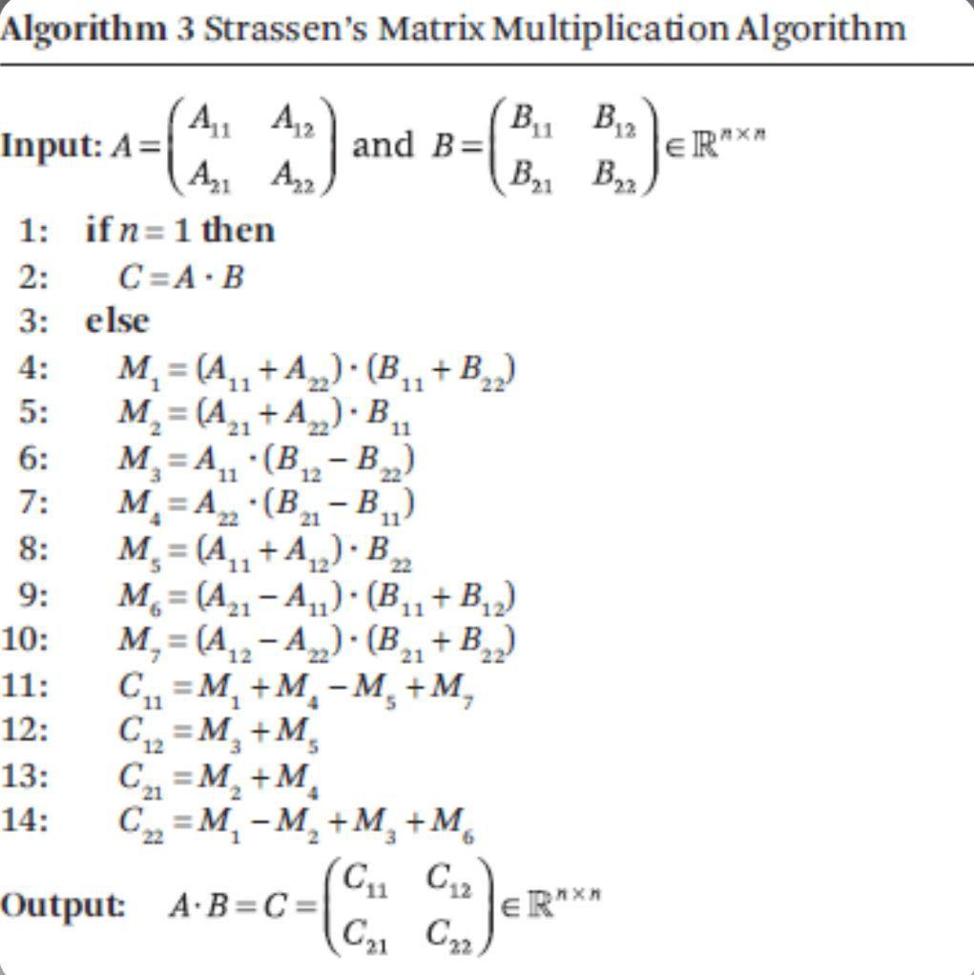

Slide 79
Formulas for Strassen’s Algorithm
M₁ = (A₁₁ + A₂₂) ∗ (B₁₁ + B₂₂)
M₂ = (A₂₁ + A₂₂) ∗ B₁₁
M₃ = A₁₁ ∗ (B₁₂ – B₂₂)
M₄ = A₂₂ ∗ (B₂₁ – B₁₁)
M₅ = (A₁₁ + A₁₂) ∗ B₂₂
M₆ = (A₂₁ – A₁₁) ∗ (B₁₁ + B₁₂)
M₇ = (A₁₂ – A₂₂) ∗ (B₂₁ + B₂₂)
C₁₁=M1 + M4 - M₅ + M₇
C₁₂= M₃ + M₅
C₂₁= M₂ + M₄
C₂₂=M₁ + M₃ - M₂ + M₆

Slide 80
    C₁₁ C₁₂ A₁₁ A₁₂ B₁₁ B₁₂
    = *
    C₂₁ C₂₂ A₂₁ A₂₂ B₂₁ B₂₂
    M₁ + M₄ - M₅ + M₇ M₃ + M₅
    =
    M₂ + M₄ M₁ + M₃ - M₂ + M₆
The resulting recurrence relation for T(n) is
T(n)= c₁ n<=2
7T(n/2) +c₂n² n>2

Slide 81

T(n)= 7^{k}T(1) + c₂n² 1+ 7/4 + (7/4)² + (7/4) ³+……………..+ (7/4)^{k-1}
⁼ 7^{log}₂^{n} c₁ +c₂ n² (7/4)^{log}₂^{n}
=c₁n^{log}₂⁷ + c₂n^{log}₂⁴ ( n ^{log}₂^{7-log}₂⁴ )
= c₁n^{log}₂⁷ + c₂( n^{log}₂⁴ +^{log}₂⁷ - ^{log}₂⁴ ) = c₁n^{log}₂⁷ + c₂n^{log}₂⁷
=c n^{log}₂⁷ = O(n^{log}₂⁷) ~ O( n^{2.81})
. .
.

